Slide 1
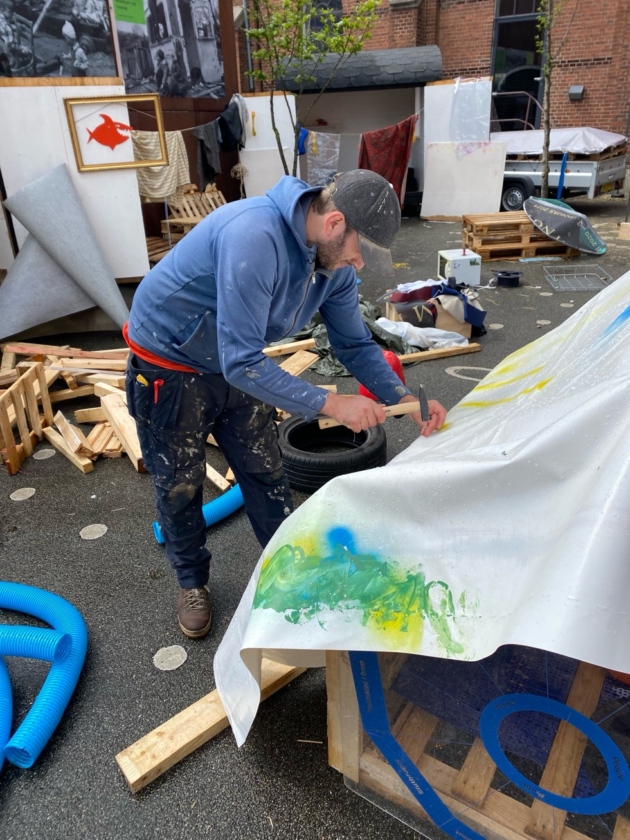

Drifting by Friction –
Playing with Ontologies of Design
Mathias Poulsen
mp@dskd.dk
Notes:
Thank you for coming – and staying!
Yesterday, I wrote on LinkedIn that I would start introducing myself not by whatever I have achieved, but by sharing my doubts, insecurities, vulnerabilities and interdependencies. In a way, that’s what the paper and this talk will aspire to do.
I have been looking forward to presenting this work – a paper that should never have been. I never intended to write a paper for DRS, because at the time I was just too busy trying to write my PhD about play and democratic participation. In that project, I suggested that the ‘junk playground’ could be an agora, a place where people could play with discarded materials as playful, bodily inquiries into relevant democratic questions and issues. Along the way, both I and the project had changed quite a lot, and I wrote the paper because I wanted to explore how we, as researchers and humans, change – must change – along with our research.
You could say that I drifted from my PhD towards this paper about drifting – and back again.

Slide 2
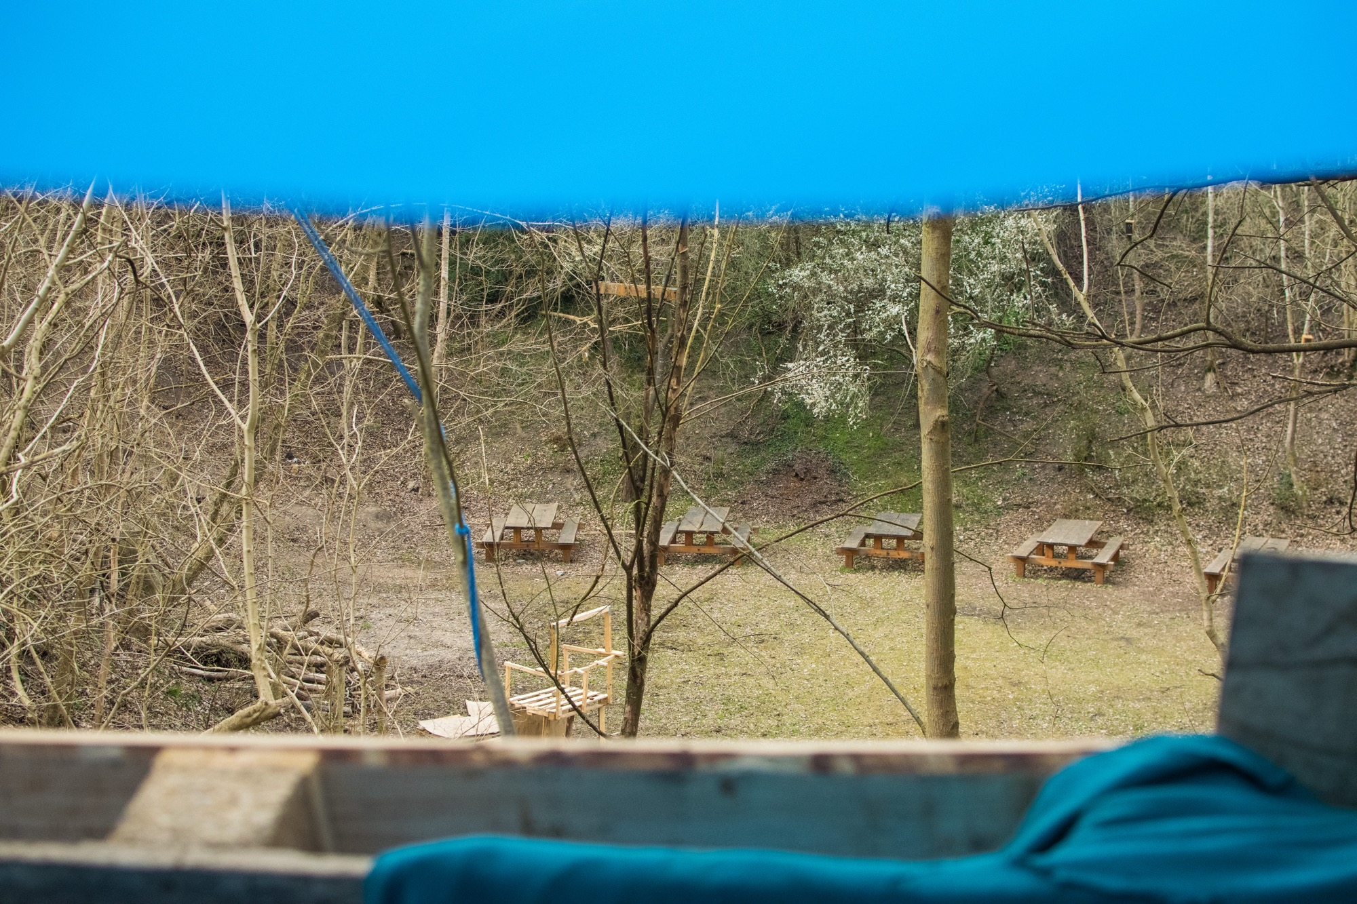
‘what needs to change is an entire way of life and a whole style of world making’ (Escobar, 2018)
Notes:
As I was writing about playful democratic participation, I was trying to grasp what that might look and feel like in a world where everything we thought we knew only seems to make matters worse. I have been happy to encounter Arturo Escobar’s work frequently this week, because I have found much inspiration in this, also when he argues that:
‘the contemporary crisis is a crisis of a particular modelo civilizatorio, or civilizational model, that of patriarchal Western capitalist modernity. () the implication is none other than everything has to change. For those for whom the current conjuncture “changes everything,” what needs to change is an entire way of life and a whole style of world making’

Slide 3
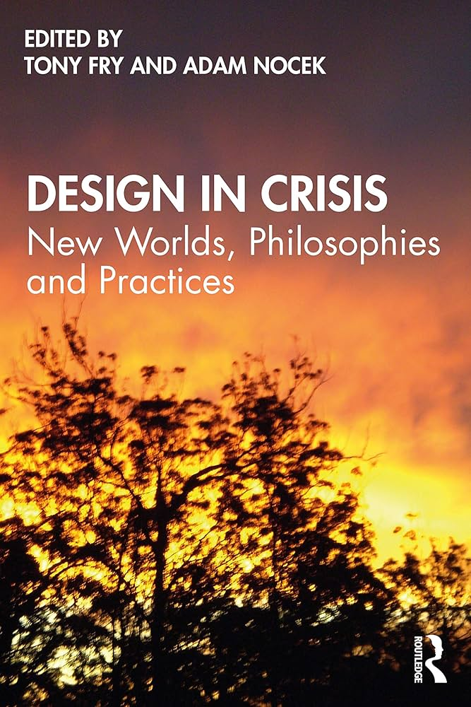
‘Design must un-design its own designing, but in so doing, it cannot make this a design project. In short: design must become unrecognisable to itself’ (Fry & Nocek, 2022)
Notes:
Along with Escobar, and in the context of design research, I have been inspired and confused by this quote from Tony Fry and Adam Nocek, when they argued that
‘design needs to respond to the problem that it helped bring into being by becoming other than itself () Design must un-design its own designing, but in so doing, it cannot make this a design project. In short: design must become unrecognisable to itself’ (Fry & Nocek, 2022)
When I wrote the paper, and today, I don’t know exactly what this means, but it remains intriguing to me, it reverberates through my thinking, and it creates the kind of friction I am always after.

Slide 4
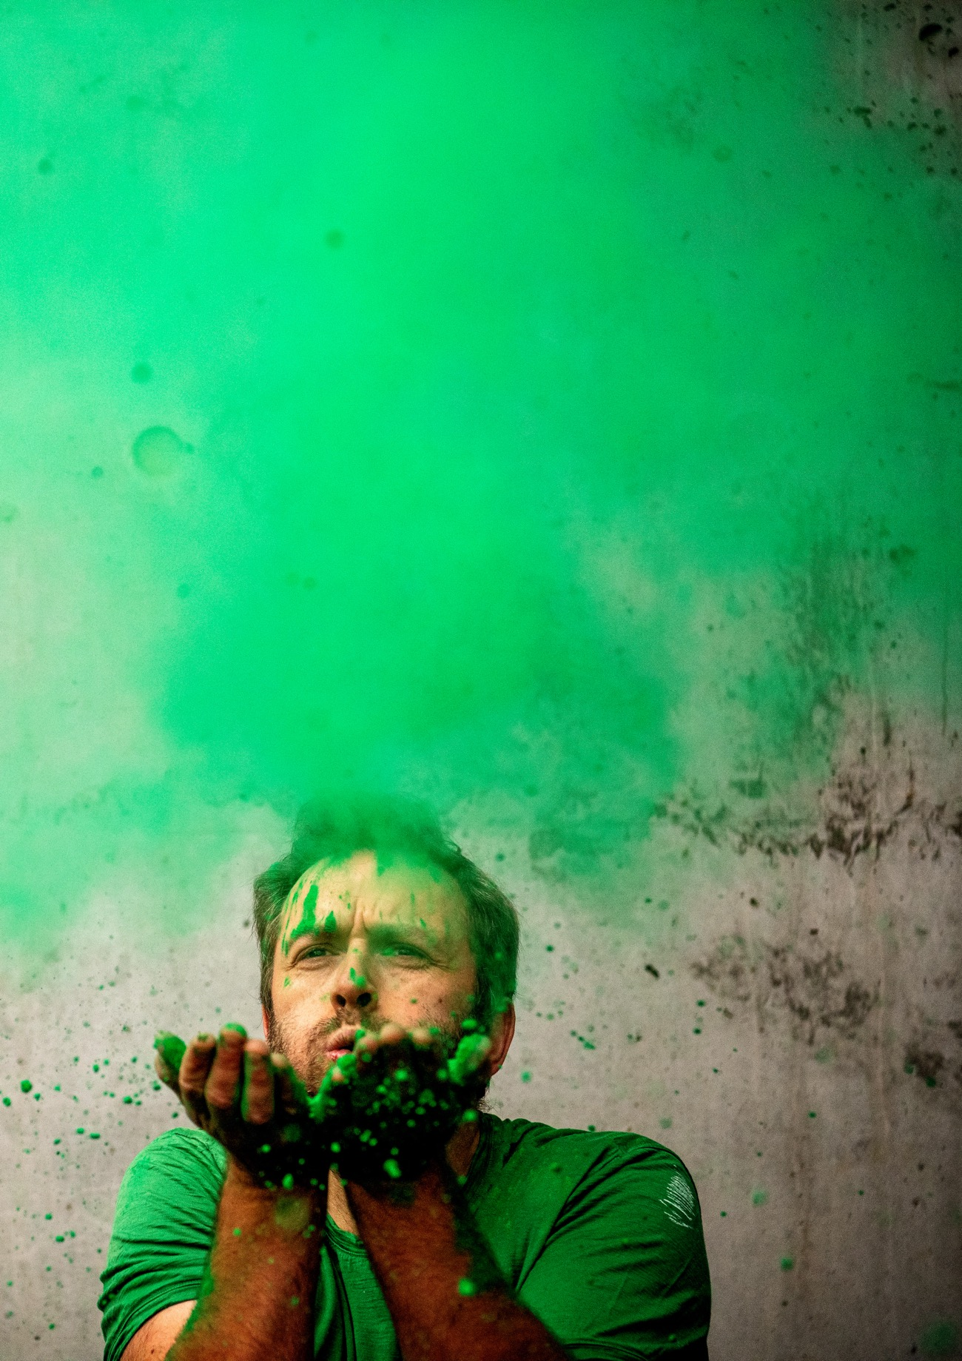
If everything has to change, and if design must become unrecognisable to itself – where does that leave me?
Notes:
So - If everything has to change, and if design must become unrecognisable to itself – where does that leave me?
In the paper, I asked: ‘How could we see what we could not see if we did not change enough to see differently?’
What happens to my worldview, my epistemological and ontological convictions, how I think about knowing and becoming, my very existence in the world?
I don’t know, but I have suggested that I would have to risk it all, to cautiously step into spaces, situations and affective states where I could and would have to become otherwise. It was necessary for me to actively change with the worlds I have tried to enact and explore.

Slide 5
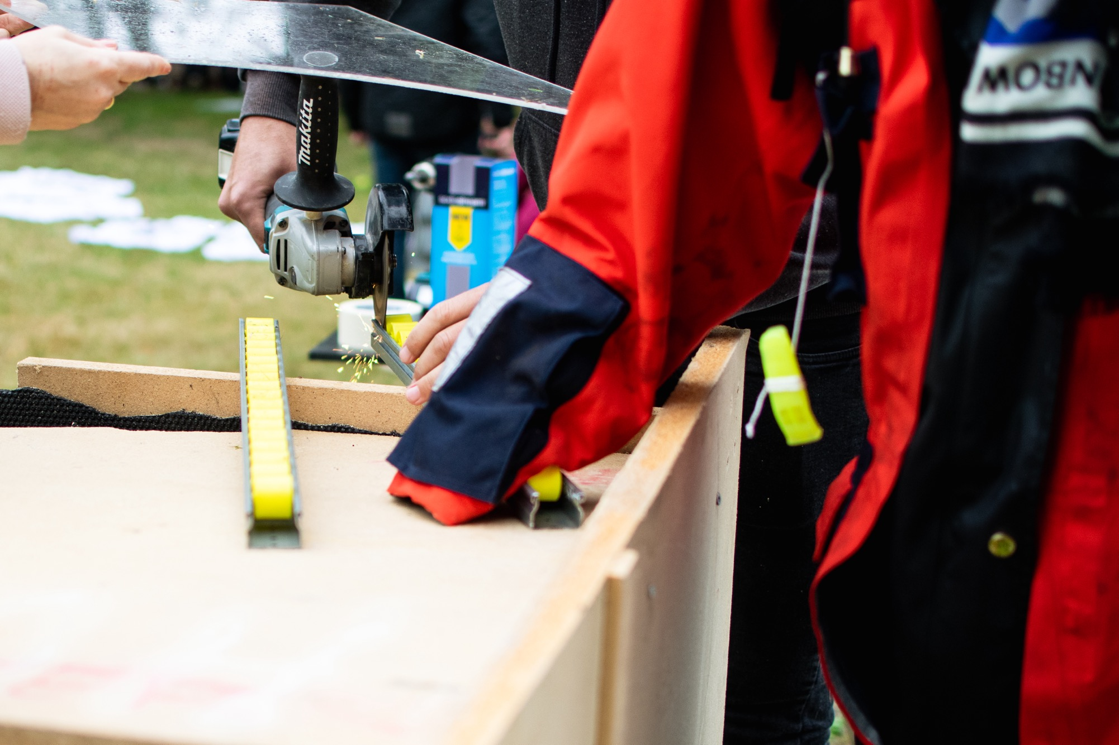
What happens if a design research project drifts by following and enhancing the frictions?
Notes:
I used the concept of ‘drifting’ to trace this process of change. As you may know, Peter Gall Krogh and Ilpo Koskinen defined drifting as ‘those actions that take design away from its original brief or question and lead to a result that was not anticipated in the beginning’ - (Krogh & Koskinen, 2020, p. v)
Where they thought of drifting as intentional, as a rally car drifting through the turn, it felt different to me. I was less in control, and I didn’t drift in pursuit of a specific goal. Rather, I drifted by following all the immense friction that I encountered along the way.
When I talk about friction, I begin with Merriam-Webster’s definition as ‘the rubbing of one body against another’. Kathleen Stewart can help us see how we might sense friction as an affective phenomenon, as a ‘surging, a rubbing, a connection of some kind that has an impact () bodies literally affecting one another and generating intensities: human bodies, discursive bodies, bodies of thought, bodies of water’ (Stewart, 2007, p. 128). it goes beyond the tangible, as it also includes friction with existing ideas and expectations, and with ways of knowing and being. Anything can rub up against anything, and friction can ensue from any encounter.
If you were at the keynote this morning, you will know that ‘friction creates a tingling feeling’ – for instance if you’re rubbing your hands together really fast.

Slide 6
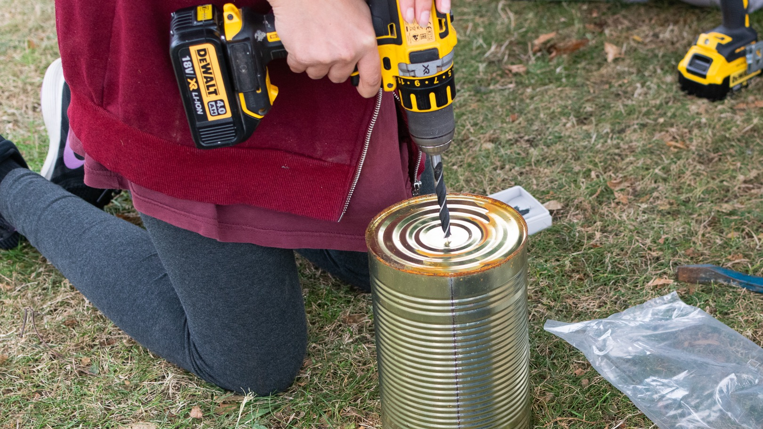
Friction with materials
Notes:
In the paper, I tell these stories of friction - ‘friction tales’, as I call them. These are stories of encounters that generated friction, with people, with expectations, with ideas, with materials, with organisations, with epistemologies, ontologies, with worldmaking practices.
I tell one story about the people in the playgrounds, and how they often found it difficult to make any sense of all the discarded materials. Discarded materials seem to be less clear about their affordances and purpose, about how they can be used, they are more open-ended – and hence, often more confusing to us, when we are used to seeking linear trajectories and clearly defined tasks and outcomes.

Slide 7
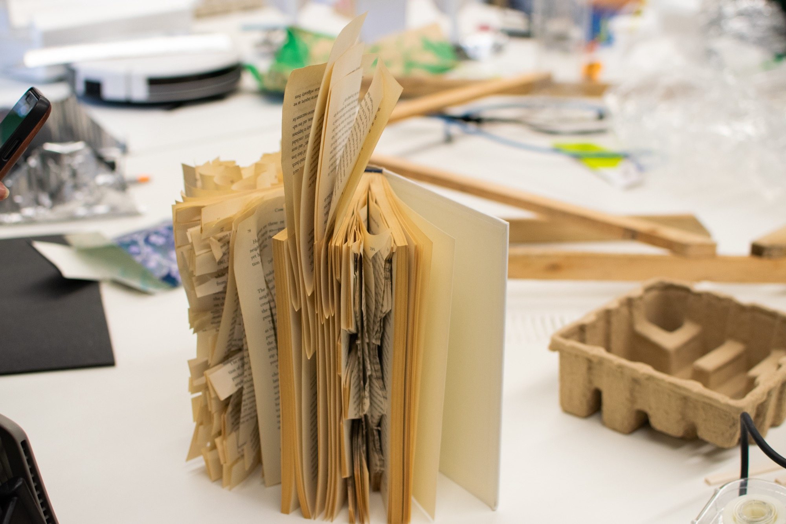
Friction with (design) research
‘Design has long been a practice of smoothing away the rough edges of the world'
Notes:
In another tale, I share how I have struggled with the expectations (including my own) that research should be done in certain ways, following certain standards, methods and so on, to reduce complexity, to find answers, create solutions and – you know the drill.
Even those of us who acknowledge and embrace the messiness of design research typically share the belief that it must be dealt with, somehow, that mess must become order in the end, and that it’s our primary job to make friction go away. As the faintest of whispers, almost drowned out by modern ideals, I hear myself ask: What if it’s not?

Slide 8
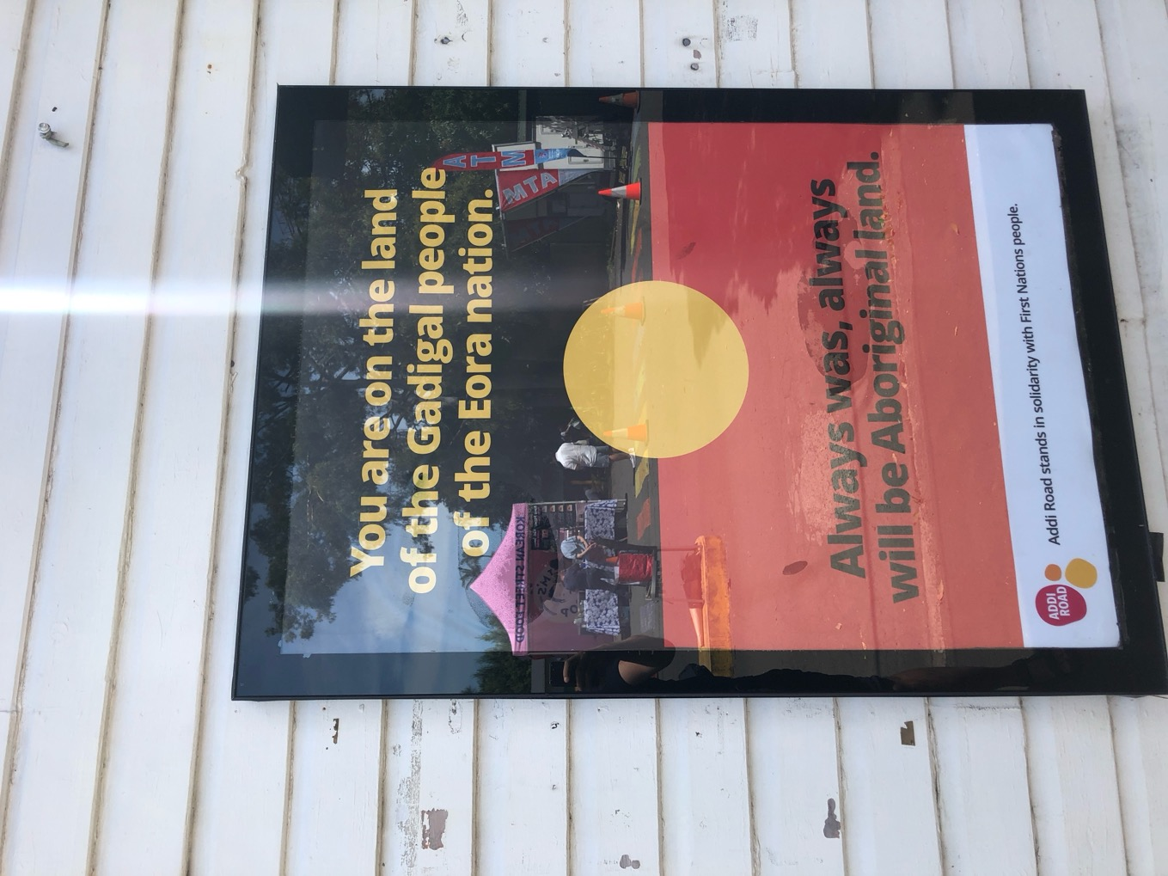
Rational discourse – on stolen land?
Notes:
This last tale is from Australia. I was visiting the Centre for Deliberative Democracy and Global Governance. Professor Nicole Curato was giving her inaugural lecture and asked ‘Shouldn't I be celebrating the mainstreaming of deliberative democracy around the world?’. She then immediately revealed that ‘something doesn't feel quite right’. She turned the tables, questioning her own work and that of her colleagues. ‘Is deliberation, rooted as it is in Habermasian ideals from Eurocentric enlightenment and western modernity, enough?’ she asked rhetorically. ‘We include indigenous people in citizen assemblies but doesn't this just tiptoe around the issue - that we are standing on stolen land?’
I was – and is – so deeply affected by this.

Slide 9
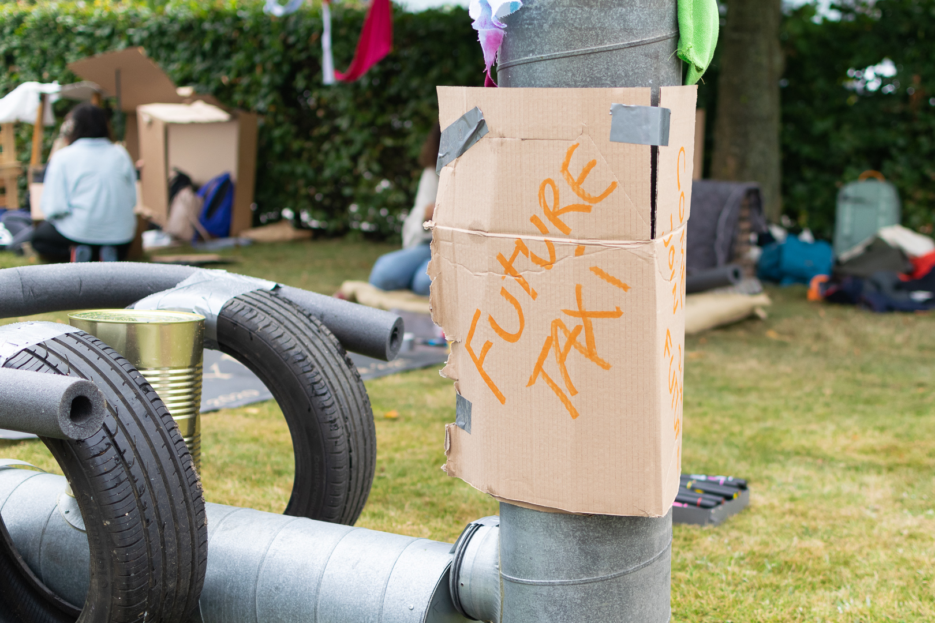
Sensing Ontological Friction in the Borderlands
‘something that invades your emotions, and your body responds to it, dictating to the mind what the mind must start thinking, changing its direction, shifting the geography of reasoning’ (Mignolo, 2018).
Notes:
I do not mean to suggest 'drifting by friction’ as a method, it comes with no guarantees, it is perhaps more like an orientation, a sensitivity and a capacity we can develop. It calls for affective attunement, and it also calls for ‘pluriversal’ ways of knowing, being and becoming. As Walter Mignolo wrote in relation to going into the ‘borderlands’, this is ‘something that invades your emotions, and your body responds to it, dictating to the mind what the mind must start thinking, changing its direction, shifting the geography of reasoning’ (Mignolo, 2018).
Drifting by friction means turning towards the friction, not away from it, enhancing it rather than resolving or ignoring it altogether. Drifting by friction means accepting the invitation to be shaken by the ruptures, to be loosened and transformed, to become otherwise and potentially unrecognisable to oneself.’ In other words, it led me to question the logic of Western Modernity, where we are all rational, autonomous individuals. That is not who I am anymore.

Slide 10
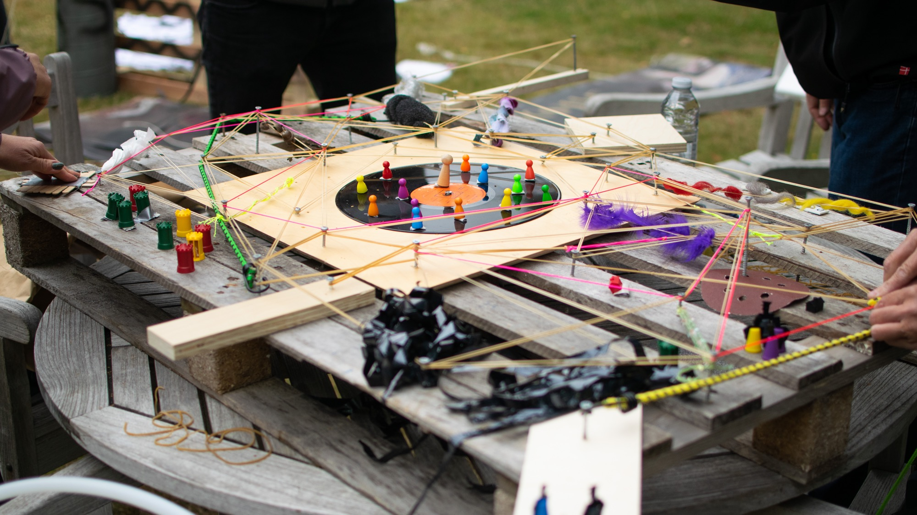
Playing with friction
Notes:
The people in the playgorunds have been playing, but what is the role of play for me in my work?
It is crucial, I pursue play in everything that I do – and I believe that it helps me. Play thrives on friction, tension, ambivalence, on not knowing, and simply doing whatever it takes to keep the play experience alive and vibrant.
When I play and when I feel playful, I can linger with the friction for much longer, I am less fearful, less concerned that my drifting leads nowhere. I am excited to go on adventures, to let myself become otherwise, transformed by whatever happens.

Slide 11
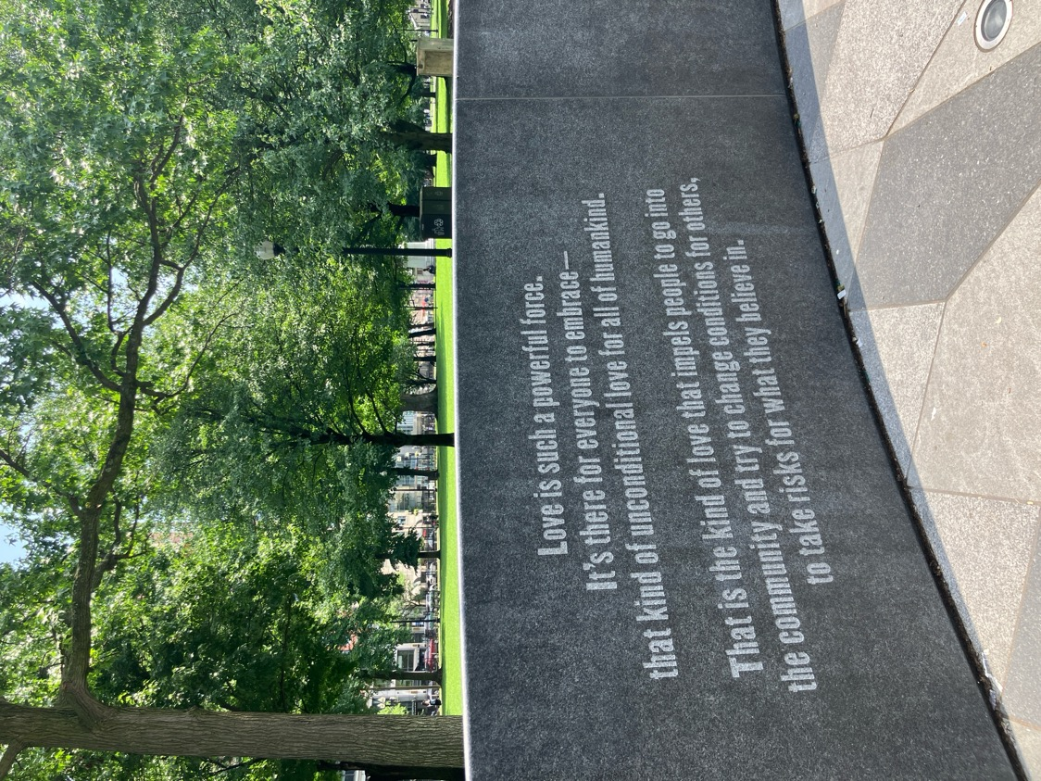
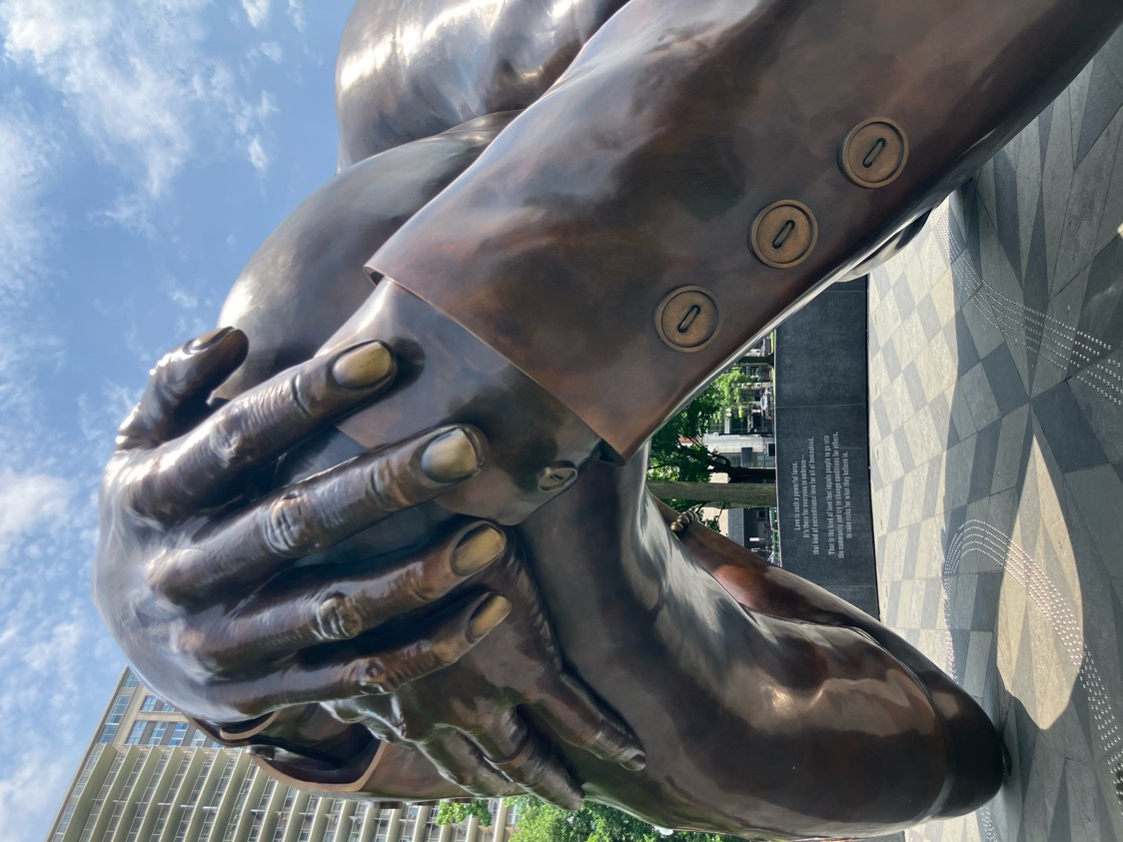
Love and collective courage
Drifting towards a relational ontology, deep entanglement and – maybe – a greater love for the work and the world(s)
Notes:
As I was having a hard time figuring out how to end the thesis, it dawned on me that perhaps the one most important pattern across the many pages were to be found in a series of turns to loveh. Now, I find it difficult to talk about love, but if there is one thing ‘drifting by friction’ has taught me, it is that we have to start talking about things before we are ready to talk about them.
‘When women and men under­ stand that working to eradicate patriarchal domination is a struggle rooted in the longing to make a world where everyone can live fully and freely, then we know our work to be a gesture of love. Let us draw upon that love to heighten our awareness, deepen our compassion, intensify our courage, and strengthen our commitment.’ (hooks, 2015, p. 27)

Slide 12
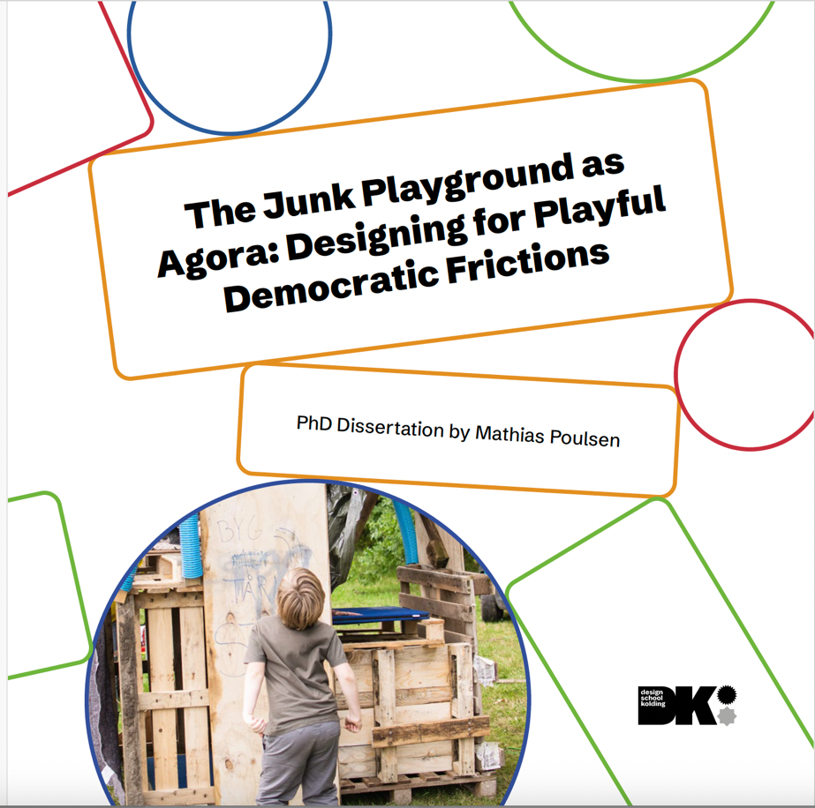
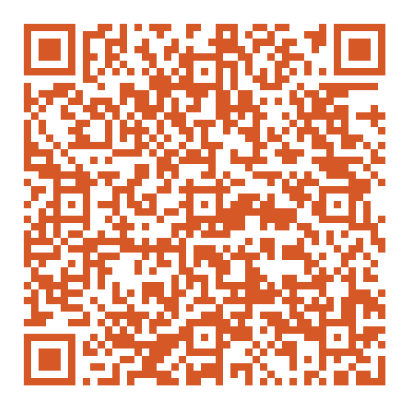
Link to my thesis
THANK YOU!
Mathias Poulsen
mp@dskd.dk

